Slide 1


Slide 2

Who Watches the Watchmen
Introducing a Better Metric of your Codes’ Quality
Matthew Knowles
Software Craftsman at Emmersion Learning
www.EmmersionLearning.com
@MatthewYKnowles
Matthew.Knowles@EmmersionLearning.com

Slide 3
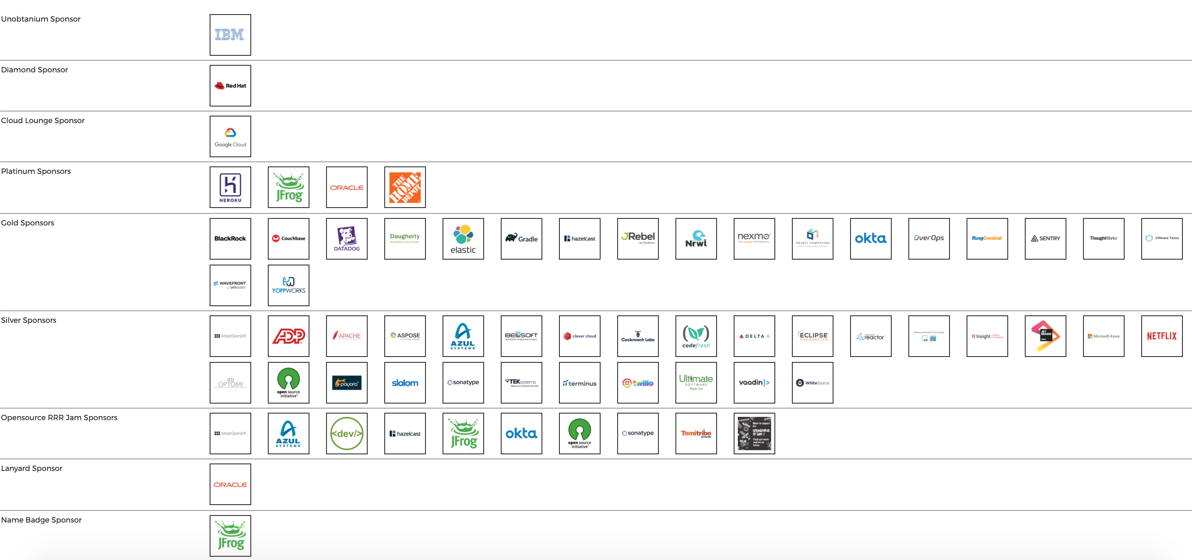

Slide 4
Tests
Notes:
We are going to talk a lot today about specific types of tests but lets first start zoomed out and ask why do we write tests? What reasons do y’all have for writing tests?

Slide 5
Why Write Tests?
Verify functionality
Defend against unexpected change
Executable documentation of the code
Notes:
These are generally the reasons I hear for writing tests.
Executable documentation of code is maybe an outlier here but what I mean by that is if someone asked me what the current project that I am working on does I would immediately look to the UI/E2E testing suite and start reading off test names.
You can login create a support ticket and receive a confirmation email
You can login upload a log file
You can login and download the latest version of the software

Slide 6
What is Driving Companies to Adopt Automated Testing?
Notes:
More and more companies are starting to embrace automated testing and are thinking about testing earlier and earlier in the development cycle.
Just because I am interested - how many people in here practice Test Driven Development at their job?

Slide 7
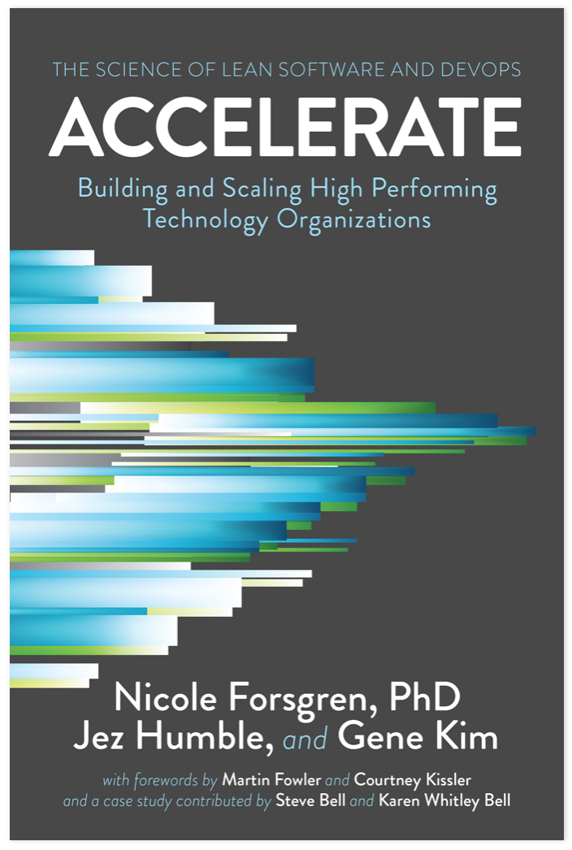
Notes:
How many of you have read this book?
Does anyone remember what the 4 “Key Metrics of Success” were?

Slide 8
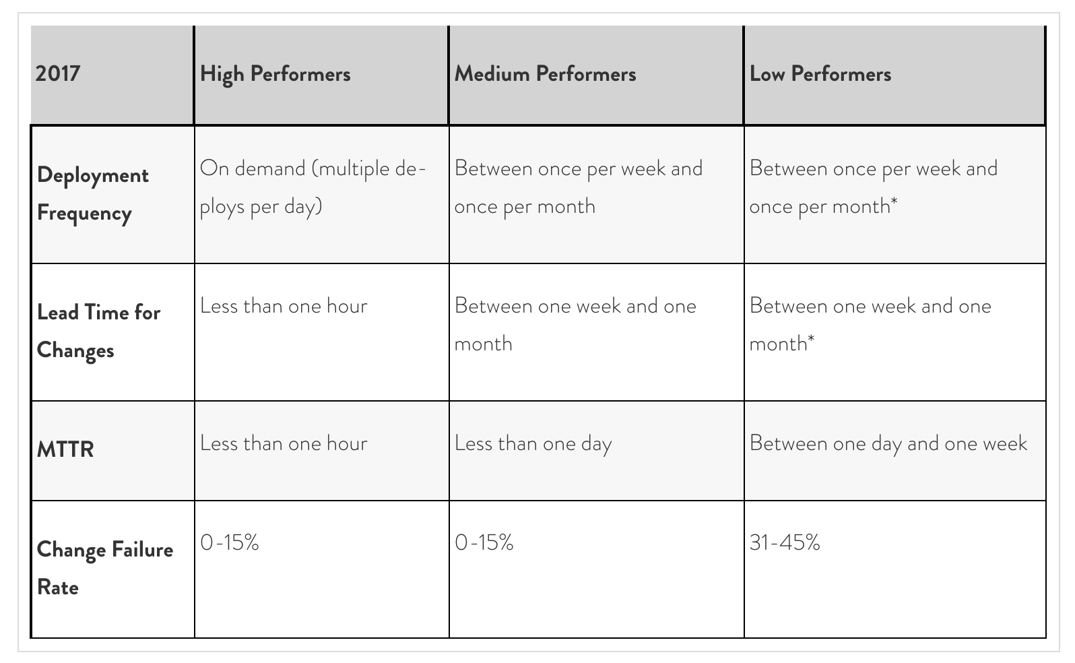
Notes:
The findings of Accelerate can basically be summed up to the best measurable predictor of team success is how they perform on these ”4 Key Metrics”
What does this have to do with the quality of my test suite?
As teams are trying to move into that “High Performers” category they have to start deploying multiple times a day which can pretty quickly overwhelm a manual QA team.
Lead time for changes general decreases if you can make a fix, run your tests, and if they pass confidently deploy to production.
Mean Time to Recovery is more indictive of the quality of your DevOps and how quickly you can roll back a deploy
Change Failure Rate should decrease as the quality of your test suite increases

Slide 9
How to Measure a Test Suite’s Quality?
Notes:
How do you know how good your tests are? How confident are you that mistakes in the code will get captured by your tests? Do you currently have a way to measure your test quality? What do you use?

Slide 10
Code Coverage
Notes:
A lot of companies would say code coverage is their metric of test quality. Lets take a look at a code coverage analysis and see what it looks like

Slide 11
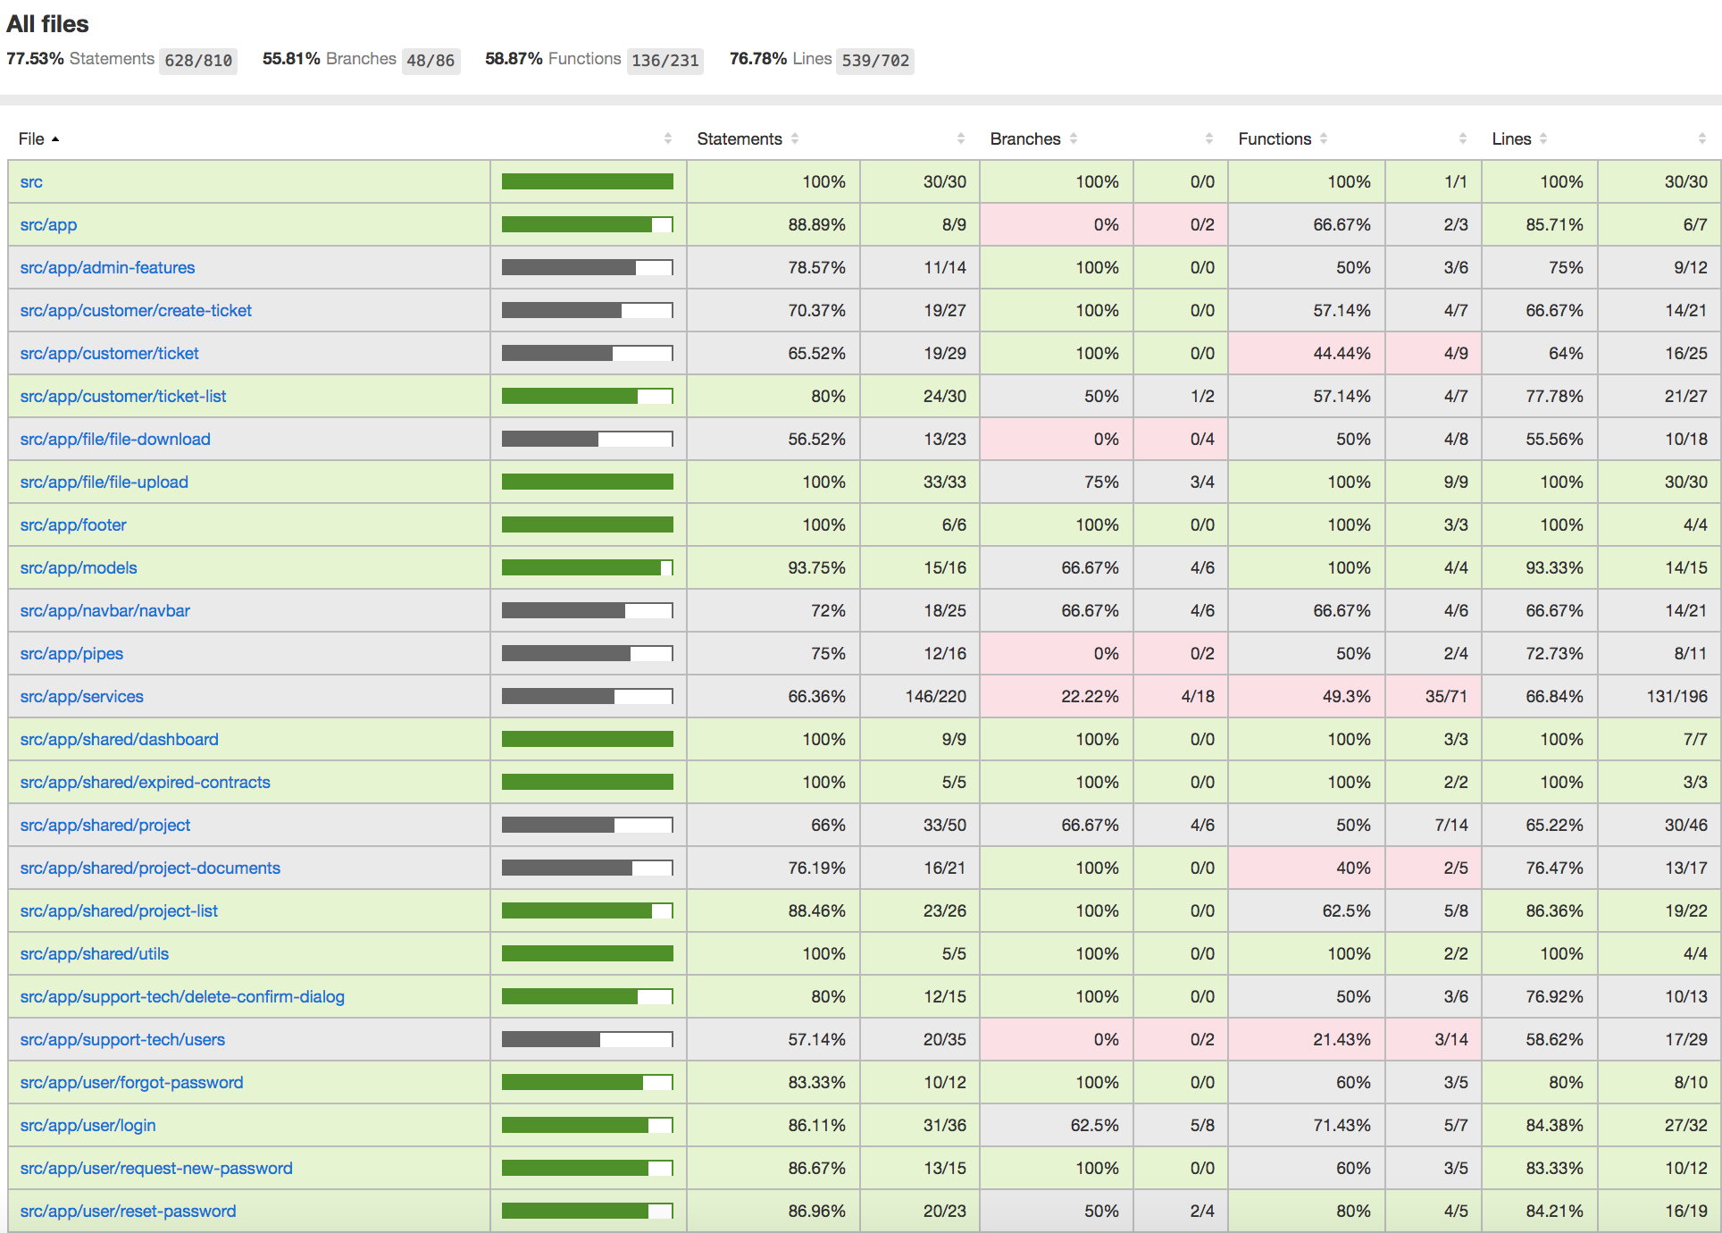
Notes:
This a coverage analysis a project in JavaScript. Is this a good amount of coverage? What amount of coverage would make you feel confident in the quality of your test suite?

Slide 12
How is code coverage calculated?
Notes:
Does anyone know how code coverage is calculated? What does it mean to have 100% code coverage?

Slide 13
What does this tell you about the quality of your tests?
Notes:
I will get into some of the shortcomings of code coverage with a coding demo in a few minutes but the way that we use code coverage at my company is not to know what code already has high quality tests but instead as an indicator of what code is not tested. If I have code that is 80% covered then I know for sure that 20% of the code does not have tests verifying the logic.

Slide 14
Does 100% Code Coverage Give You Confidence to Change your Code and Deploy it to a Customer?
Notes:
Does having high coverage itself give you confidence to deploy to your customer?

Slide 15
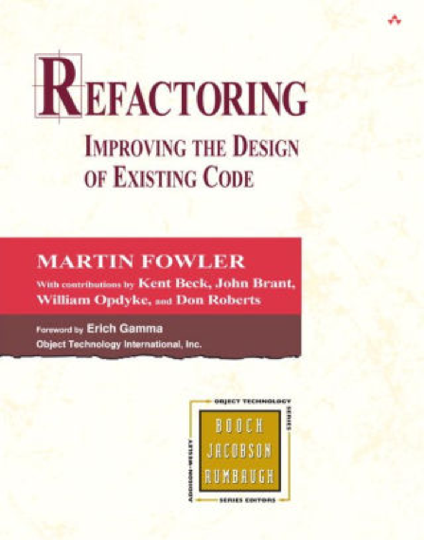
Add functionality to legacy code
Code Coverage
Limitations of Code Coverage
Mutation Testing
https://github.com/MatthewYKnowles/who-watches-the-watchmen.git

Slide 16
How would you mutate this code?
1. a < b
2. a || b
3. a == b
4. if(a > b) {return a+b}
5. if(b > a) {a++}

Slide 17
Mutation Testing - sounds awesome, why have I never heard of it?

Slide 18
When to run Mutation Testing

Slide 19

As hard-nosed as I am about TDD as a necessary discipline; if I saw a team using mutation testing to guarantee the semantic stability of a test-after suite; I would smile, and nod, and consider them to be highly professional. (I would also suggest that they work test-first in order to streamline their effort.)
-Robert Martin (Uncle Bob)

Slide 20
Mutation Testing Frameworks
JavaScript – Stryker
Java – PiTest
C# - Stryker and Visual Mutator

Slide 21
Questions?
Further Reading:
Filip van Laenen – Mutation Testing: Better Code by Making Bugs
Martin Fowler – Refactoring
@MatthewYKnowles

